Slide 1
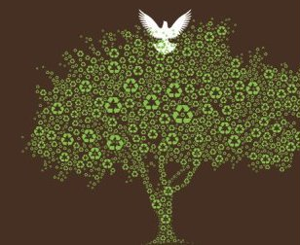
CLIMATE CHANGE
science and faith in conflict?
KATHARINE HAYHOE
TEXAS TECH UNIVERSITY

Slide 2
THE PROBLEM
Part one

Slide 3
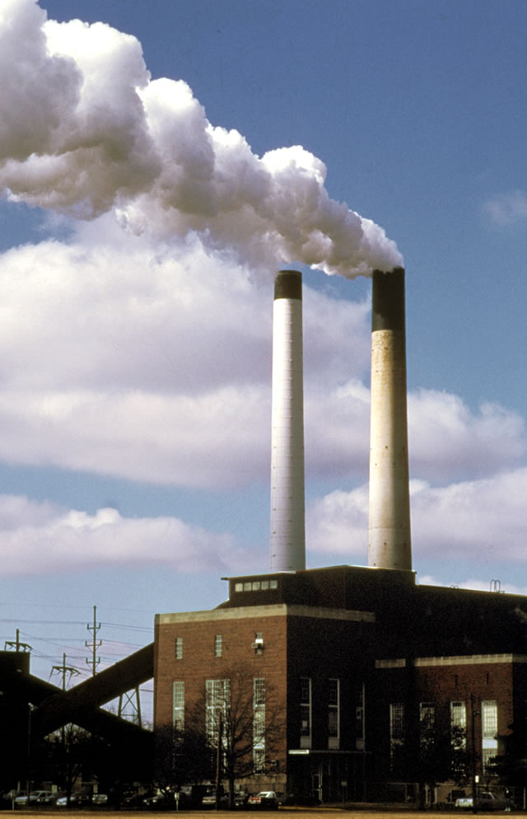
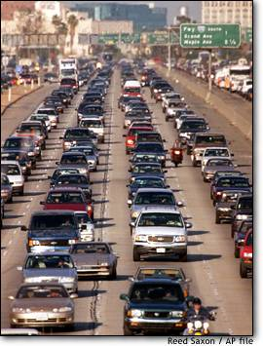
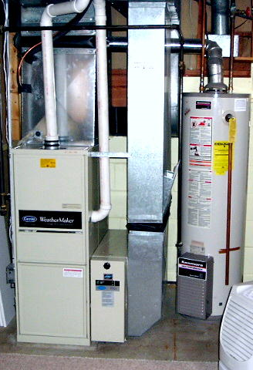
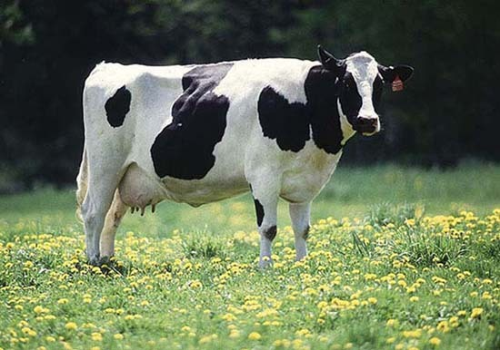
Our activities produce heat-trapping gases

Slide 4
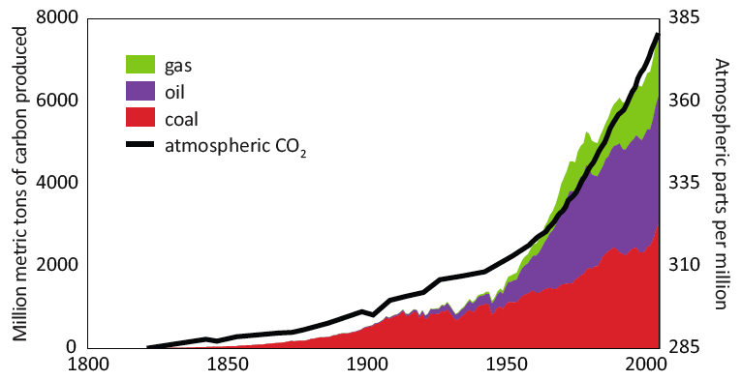
These gases are building up in the atmosphere

Slide 5
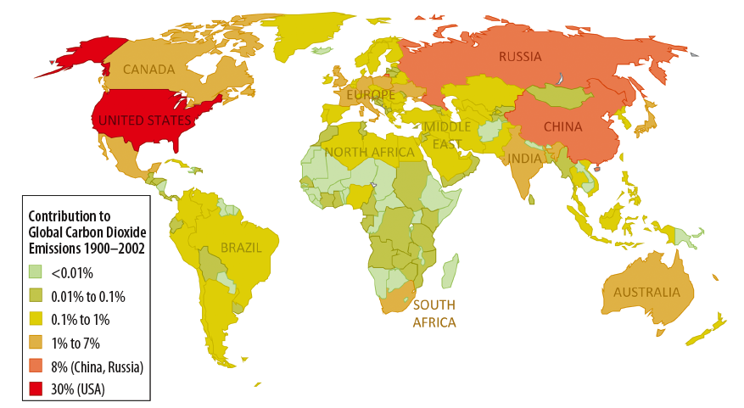
The U.S. is one of the biggest producers

Slide 6
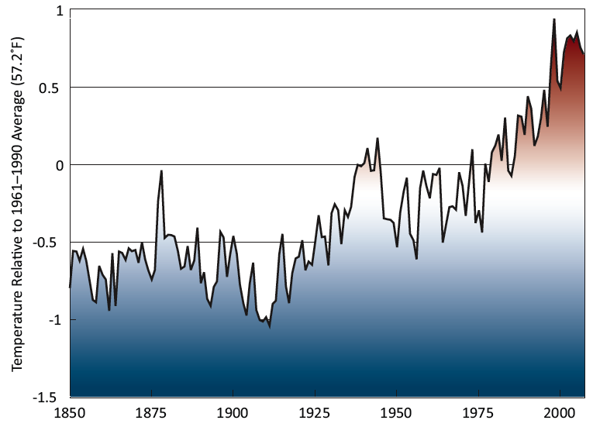
These gases trap heat in the atmosphere
2000s: warmest decade on record
2010 tied as warmest year on record

Slide 7
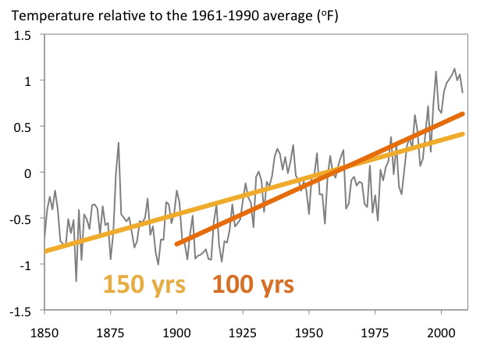
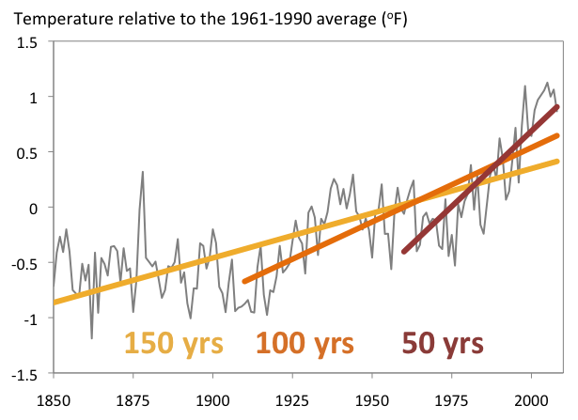
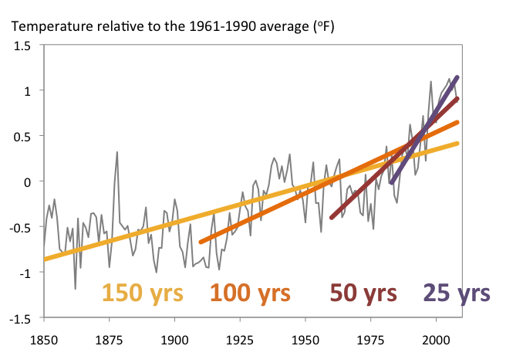
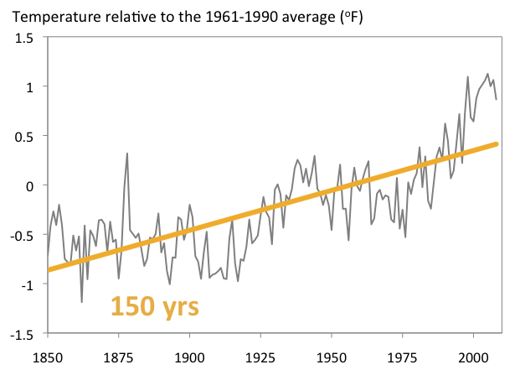
Earth’s temperature is rising faster and faster

Slide 8
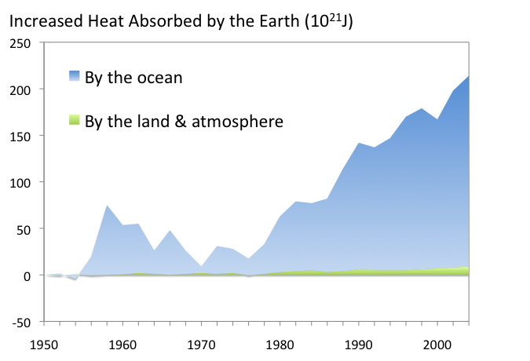
And this is just a fraction of total heating …

Slide 9
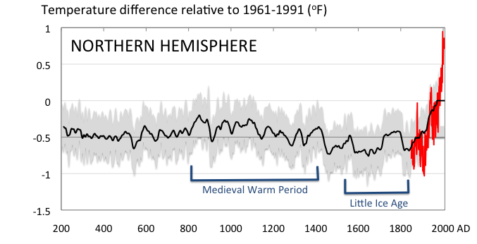
Conditions today are unusual in the context of the last 2,000 years …

Slide 10
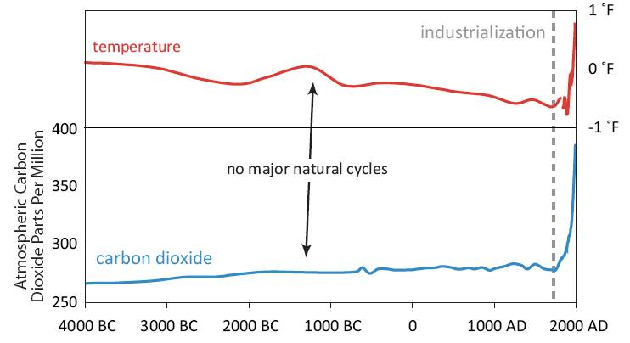
… the last 6,000 years

Slide 11
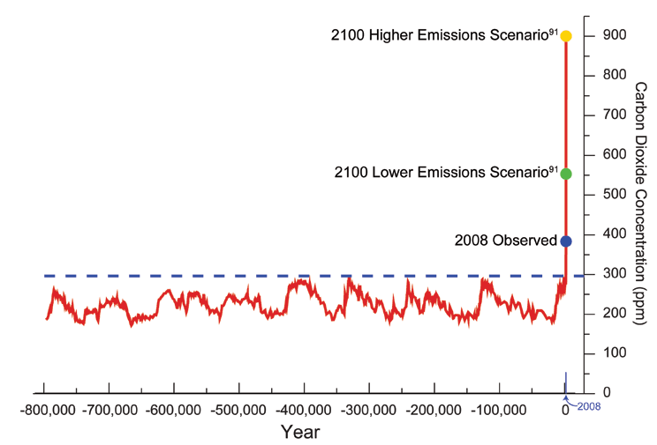
… and even the last 800,000 years

Slide 12
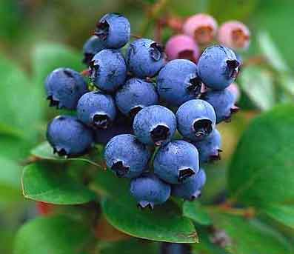
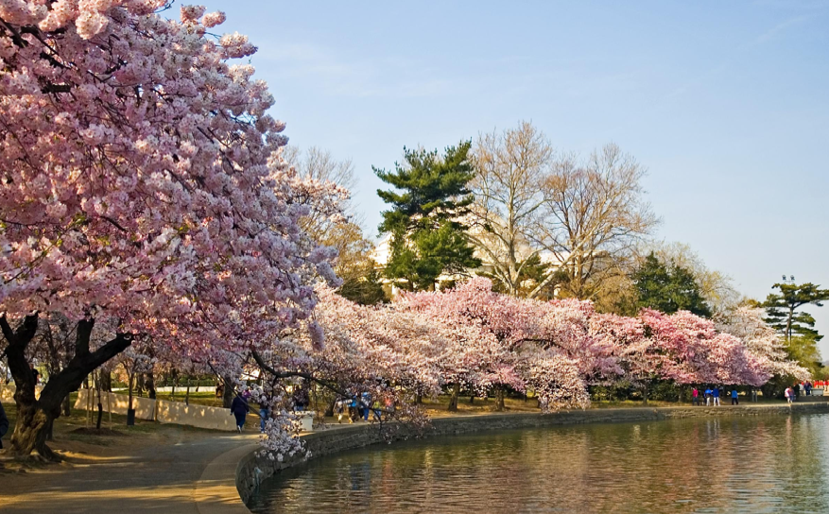
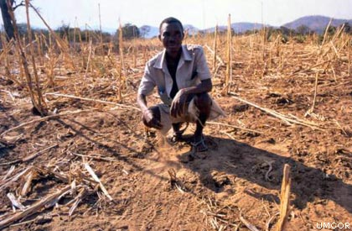
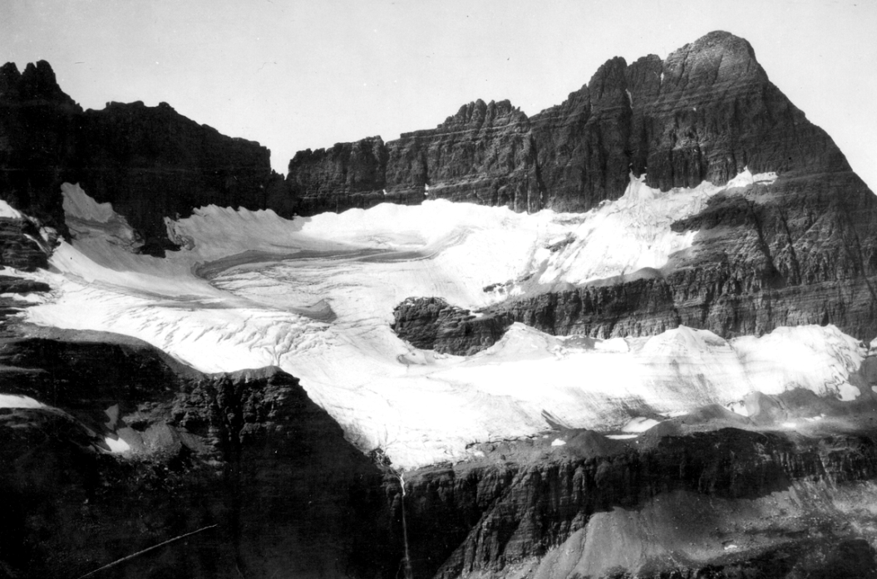
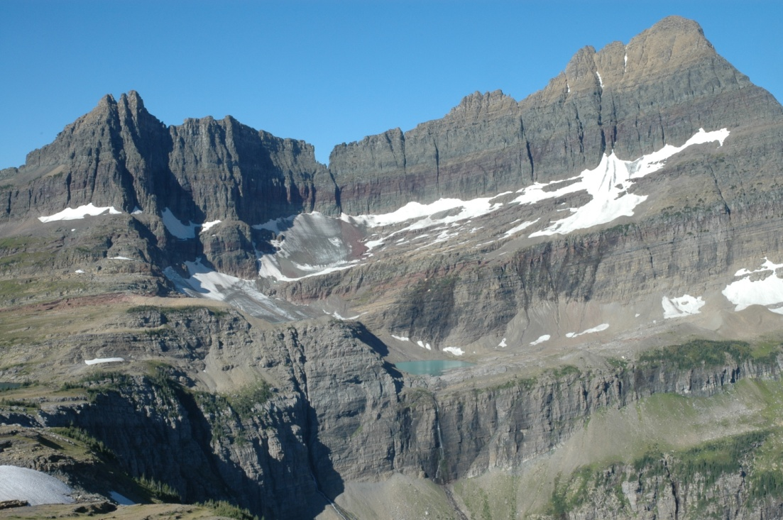
Our world is changing rapidly
Responses to warming temperatures seen in more than 25,000 physical and biological systems around the world.
Rosenzweig et al. 2008

Slide 13
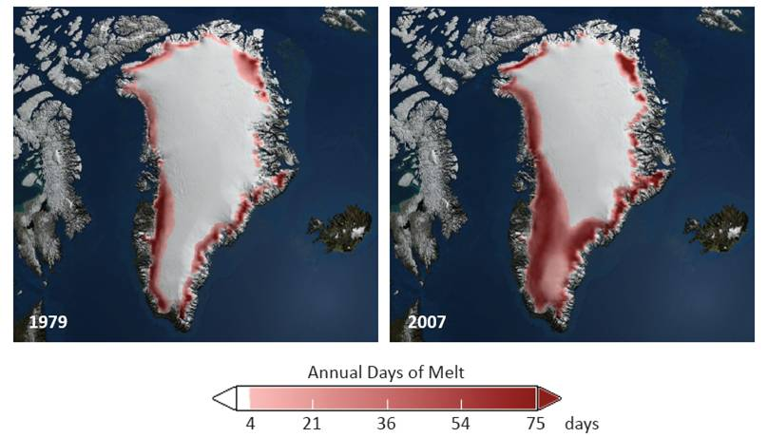
Sea level rise is accelerating, as ice sheets melt

Slide 14
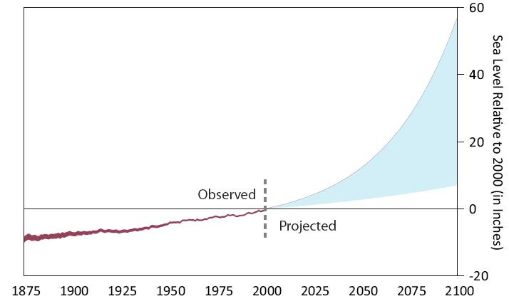
2 to 5 ft of sea level rise likely by 2100

Slide 15
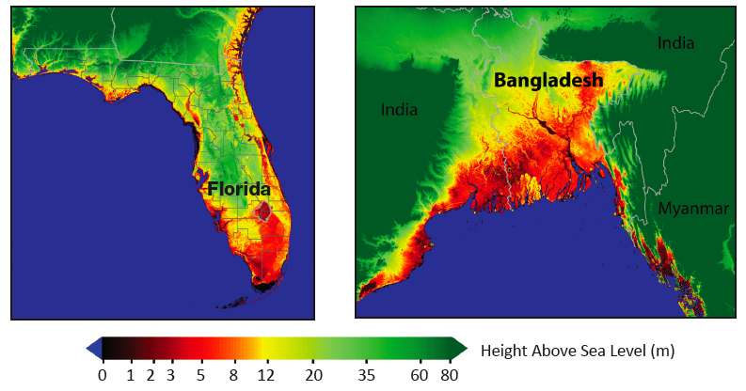
What does this mean … for our coasts?

Slide 16
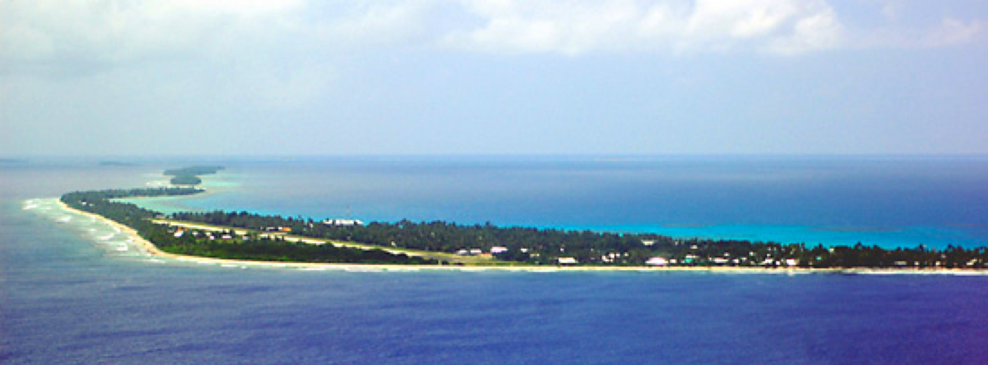
… and even entire nations?
Tuvalu, South Pacific
Notes:
Turn this into moving picture slideshow thingy where both pics are full screen and get equal time

Slide 17
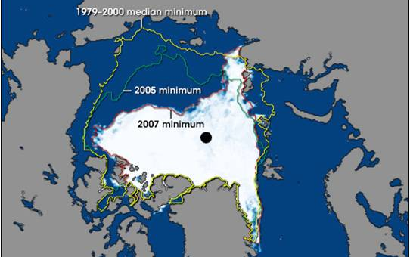
Arctic is changing, as sea ice shrinks
Notes:
Summer sea ice extent decreased 15-20% over last 40 yrs
Ice-free summers likely within a few years

Slide 18
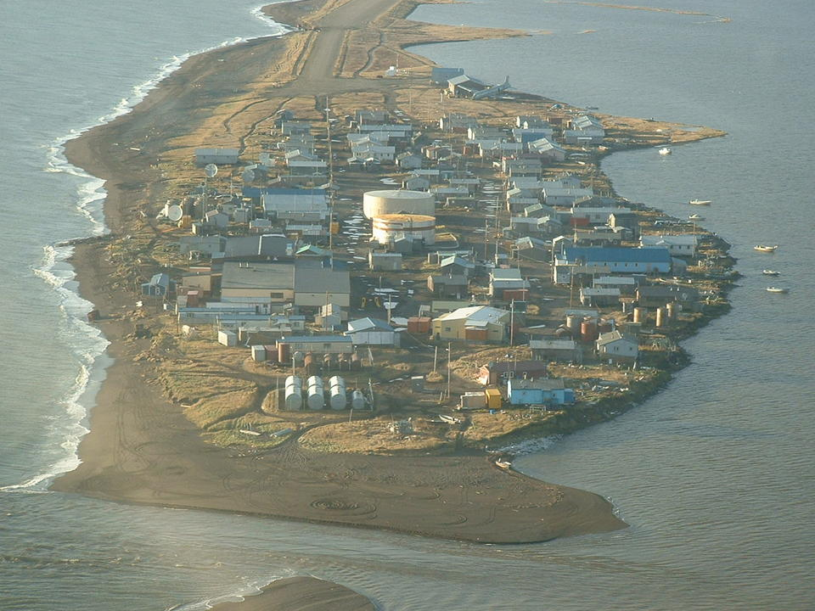
America’s first climate refugees

Slide 19
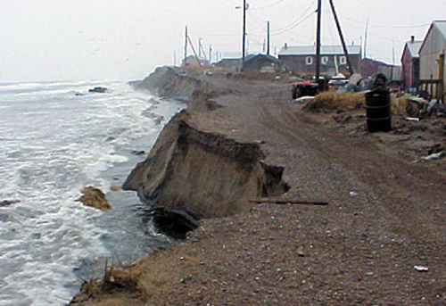
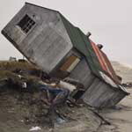
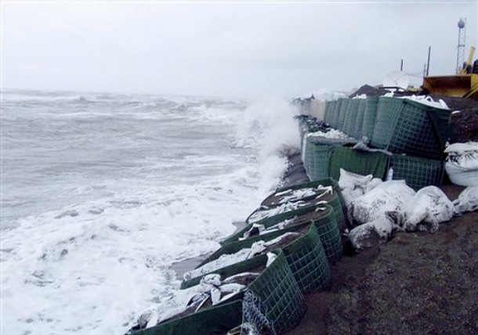
Frozen ground is melting & eroding
The people of Newtok, AK have already been driven from their homes.
Kivalina may be next.

Slide 20
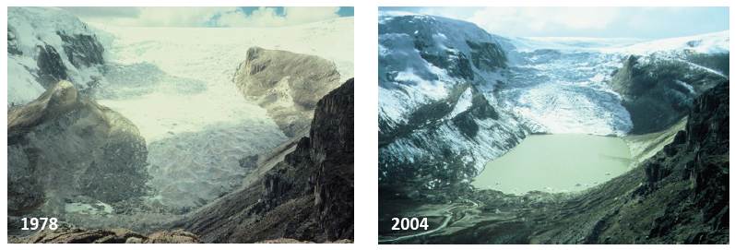
Water resources are disappearing
LIMA, PERU
8 million people
less than 2” rain per yr
1 billion depend on glacier melt for water

Slide 21
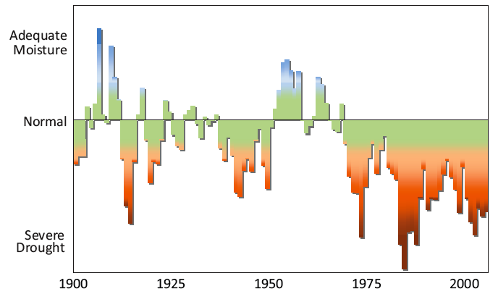
Precipitation patterns are shifting
Central Africa

Slide 22
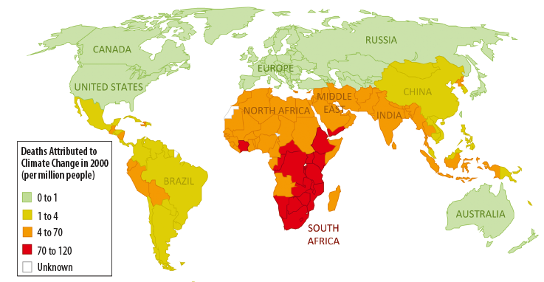
Health risks are on the rise
In 2000: 150,000 deaths per year
In 2009: 300,000 deaths per year
300 million already at risk from climate change
This century: hundreds of millions of refugees

Slide 23
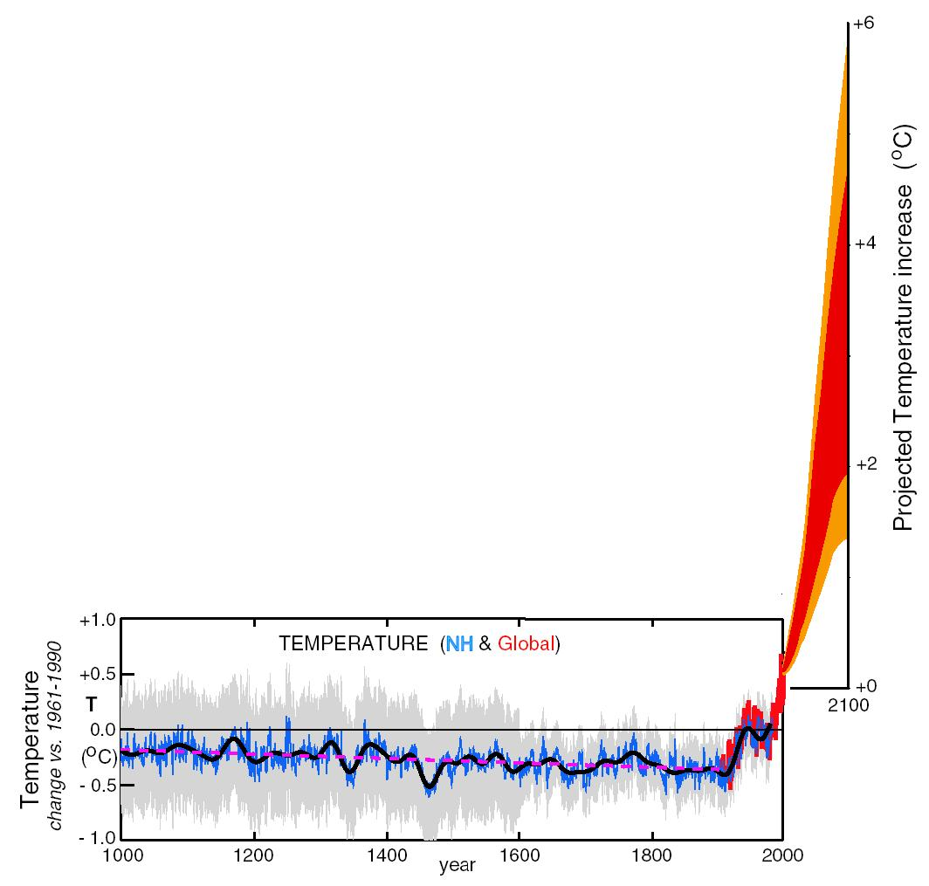
What can we expect in the future?
We’re already concerned about this
Notes:
MOVE TO BEGINNING OF MODELING SECTION

Slide 24
What can we expect in the future?
But this is what’s coming next.

Slide 25
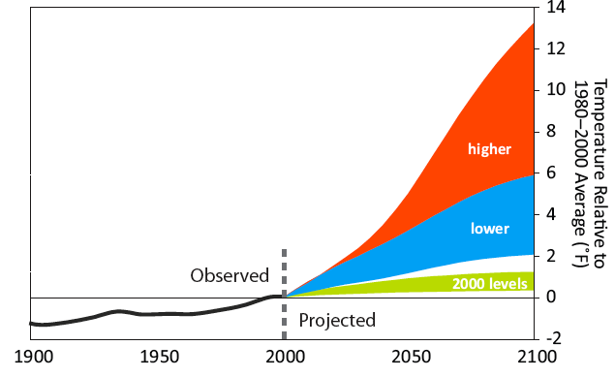
We have a (very) narrow window of time to determine how climate change will affect our own and future generations

Slide 26
What does this mean … for the US?
Weeks per Year > 100ºF (38ºC)
Historical

Slide 27
What does this mean … for the US?
Weeks per Year > 100ºF (38ºC)
Future: Lower Emissions

Slide 28
What does this mean … for the US?
Weeks per Year > 100ºF (38ºC)
Future: Higher Emissions

Slide 29
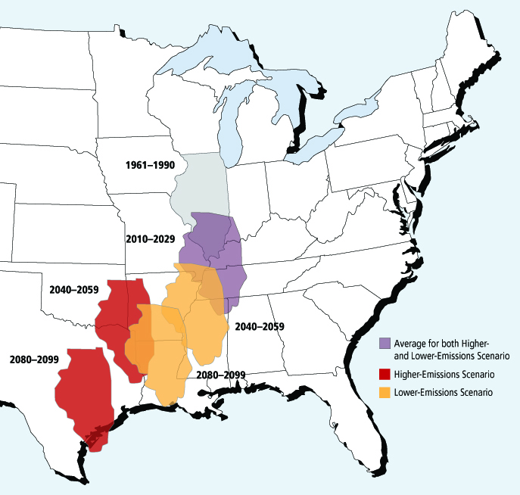
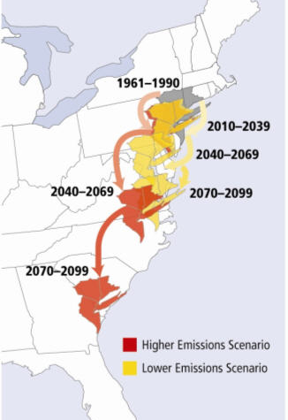
MIGRATING SUMMERS
What does this mean … for the US?

Slide 30
THE RESPONSE
Part TWO

Slide 31
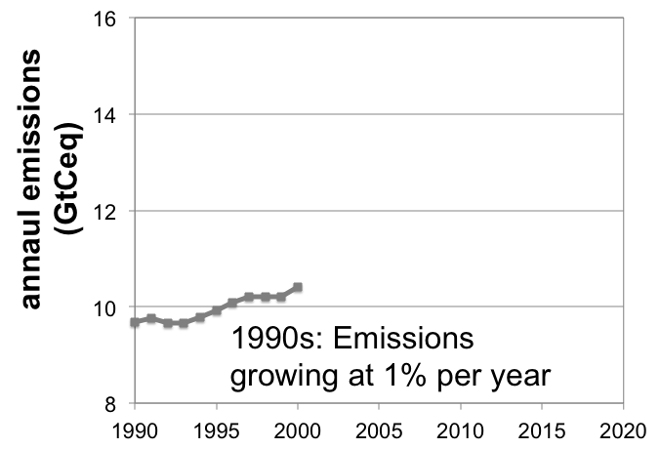
Emissions of heat-trapping gases

Slide 32
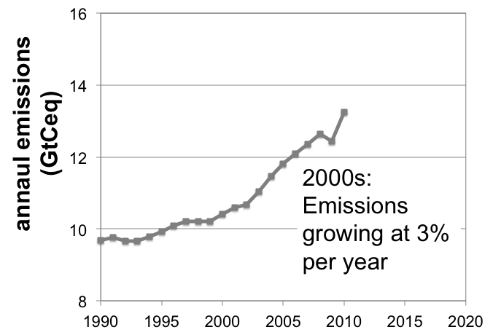
Emissions of heat-trapping gases

Slide 33
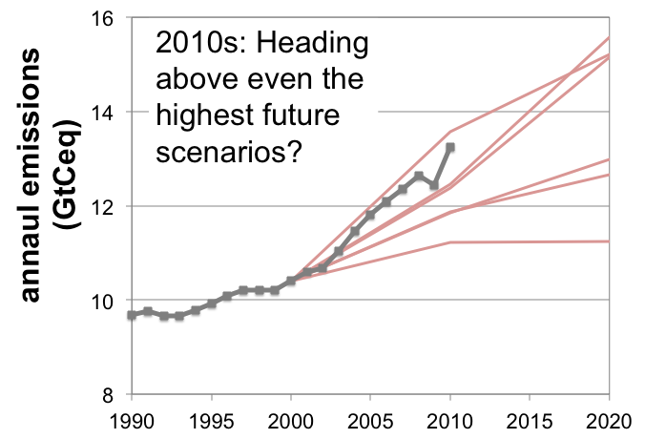
Emissions of heat-trapping gases

Slide 34
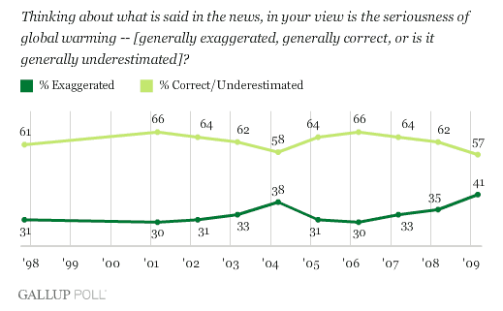
Doubt regarding the seriousness of global warming is at an all-time high

Slide 35
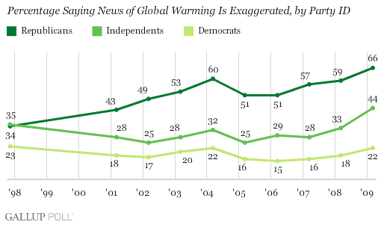
Perceptions tend to run along party lines …

Slide 36
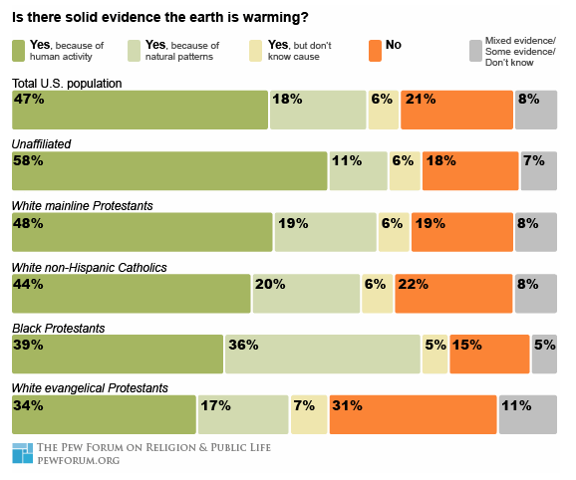
… and along religious lines.

Slide 37
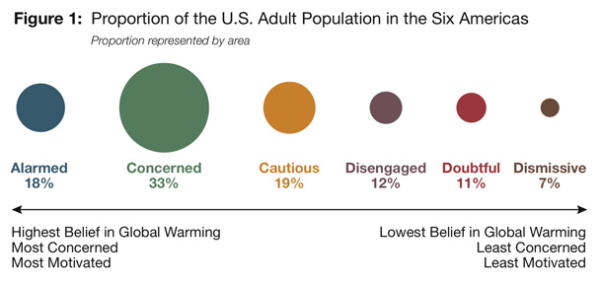
THE SIX AMERICAS SURVEY
traditional religious views,
not certain global warming is real
more conservative religious views,
certain that global warming is not real

Slide 38
WHY?
Part THREE

Slide 39
Why are science and faith in conflict?
Nearly all of us believe that …
God created the earth and it is good
The earth sustains our physical existence
Adam was given the responsibility to care for God’s creation
It is important to respect God’s creation
It is important to conserve our natural resources and budget wisely for the future
Notes:
Of course there are the historical reasons – creation and evolution. I won’t touch on those. There are several more unique to climate change, though.

Slide 40
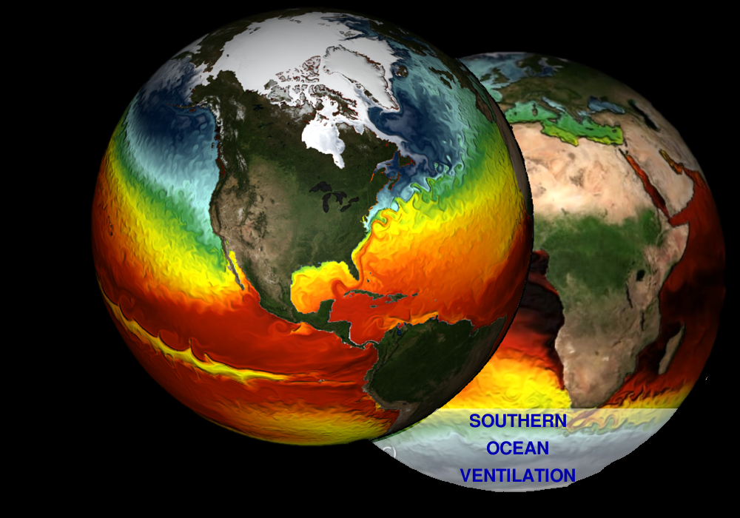
Why are science and faith in conflict?
The science is complex.
Many of the more obvious effects can’t be seen in our own backyards.
What we do see in the backyard is often counter-intuitive:
Climate change can lead to stronger snow storms, as humidity increases
Record warm winters in the Arctic can drive record cold across the Great Plains.

Slide 41
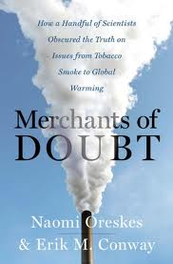
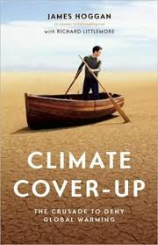
Why are science and faith in conflict?
There is a well-funded disinformation campaign at work, with the goals of:
muddying the science of climate change
promoting the idea that the science is not settled
actively opposing any legislation to limit emissions
discrediting or discouraging scientists themselves

Slide 42
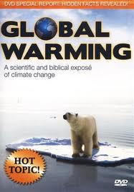
Why are science and faith in conflict?
Errors and lies are propagated by sources that Christians trust.
60% of pastors don’t think this is a real issue
100% of GOP candidates also deny its reality
conservative news pundits regularly ridicule climate science
even some Christian groups actively participate in spreading false information

Slide 43
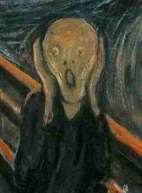
Why are science and faith in conflict?
Climate change is an daunting problem.
Even thinking about it can be overwhelming.
Doing something about it may limit or constrain goods and rights we hold dear.
Psychology tells us that it is often easier to deny the reality of a problem than to do something about it.

Slide 44
THE TRUTH ABOUT MYTHS
PART FOUR

Slide 45
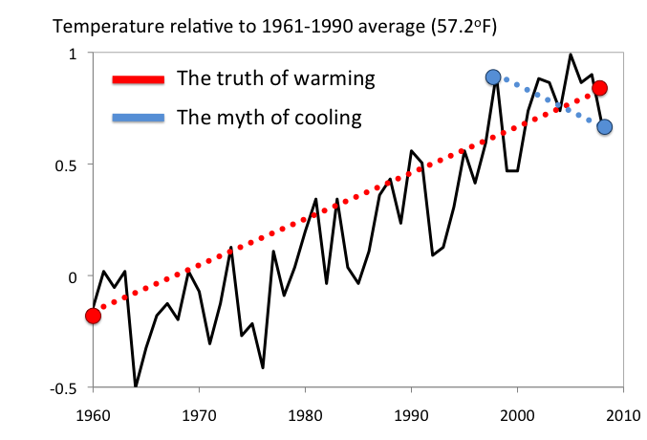
It’s cooling, not warming!

Slide 46

It’s freezing outside–where’s global warming?
WEATHER: How conditions change from day to day, or even year to year
-> unpredictable

Slide 47

It’s freezing outside–where’s global warming?
CLIMATE: The long-term average of weather over decades
-> quite predictable

Slide 48


Maybe it’s just the urban heat island effect.
Where people live
Where it’s warming fastest

Slide 49



Could it be the sun?

Slide 50

Aren’t plants to blame, more than us?
Natural carbon sources take up as much or more than they produce.
Human carbon sources absorb nothing.

Slide 51

What about natural cycles?
Today

Slide 52

It’s such a small amount …

Slide 53
There’s a scientific consensus against
MYTH: 17,000 qualified individuals signed an Oregon petition claiming global warming had no scientific basis. In reality, petition asked whether climate change was “already causing catastrophic impacts.” Scientific American identified ~200 legitimate signees, only a handful of which were in relevant fields.
  TRUTH: 98% of active scientists in related fields agree that climate change is occurring and is primarily the result of human emissions of heat-trapping gases.

Slide 54
Scientists are still arguing
Warming of the climate system is now evident from observations. Most of the increase is very likely (>90%) due to the observed increase in heat-trapping gas concentrations due to human activities [including burning fossil fuels].
Climatic change is being brought about by human-induced increases in the concentration of atmospheric carbon dioxide, primarily through the processes of combustion [burning] of fossil fuels.

Slide 55

Scientists are still arguing
Warming of the climate system is now evident from observations. Most of the increase is very likely (>90%) due to the observed increase in heat-trapping gas concentrations due to human activities [including burning fossil fuels].
The United Nations Intergovernmental Panel on Climate Change, 2007
“The Artificial Production of Carbon Dioxide and Its Influence on Temperature”
Guy Callendar, 1938
Climatic change is being brought about by human-induced increases in the concentration of atmospheric carbon dioxide, primarily through the processes of combustion [burning] of fossil fuels.

Slide 56


How do we know it’s us?

Slide 57


Quantifying the human influence

Slide 58
Why should I care?
PART FIVE

Slide 59
Why should I care? It just makes sense.
“’Everything is permissible for me’—but not everything is beneficial”
1 Corinthians 6:12
“Do not be deceived, God is not mocked; for whatever a man sows, this he will also reap.”
Galatians 6:7

Slide 60
Why should we care? Jesus says…
“Love the Lord your God with all your heart and with all your soul and with all your mind.” This is the first and greatest commandment.
And the second is like it: “Love your neighbor as yourself.”
Matthew 22:37-39

Slide 61
Today, our neighbors are being harmed
Rising sea levels, widespread drought, and rapidly disappearing glaciers are already threatening millions with loss of water, food, and even life.
Today, our global neighbors—the poor and people currently strangers to us—are most vulnerable to harm from climate-related impacts.
- A Climate for Change

Slide 62
We have 3 choices:
“We basically have three choices: mitigation, adaptation, and suffering.
We’re going to do some of each. The question is what the mix is going to be.
The more mitigation we do, the less adaptation will be required and the less suffering there will be.”
John Holdren
President’s Science Advisor; Harvard University

Slide 63
How can we respond?
The only sensible response to climate change is to reduce our own contribution to the problem, minister to the hurting, and love our global neighbors as ourselves.
“The only thing that counts is faith expressing itself through love.”
Galatians 5:6

Slide 64


1. Educate ourselves and others

Slide 65


2. Prepare for what we can’t avoid
Conserve the resources we have
Protect ourselves from what we can

Slide 66


3. Reduce our own impact
stop using this
start using this
Each US household replacing 1 light bulb
= taking 1,000,000 cars off the road (+$30 savings per bulb)

Slide 67



4. Support fundamental change
stop using this
start using this
Renewable energy gives us clean air and water, and home-grown energy sources that will never run out. So, why not?

Slide 68

CHANGE IS POSSIBLE
CHANGE IS ALREADY HAPPENING

Slide 69
THE END
FOR MORE INFORMATION
WWW.KATHARINEHAYHOE.COM
WWW.NOTBLUENOTRED.COM

Slide 70



Other Resources
How we know it’s happening and why it matters
climateforchangethebook.com
How climate change affects us here in the US
US Global Change Program
www.globalchange.gov/usimpacts
How climate change affects our global neighbors
Global Humanitarian Forum
www.ghf-geneva.org

